Slide 1
Chap. 7
Dynamic Polarization Potential - figures
4. Dynamic Polarization Potential

Slide 2
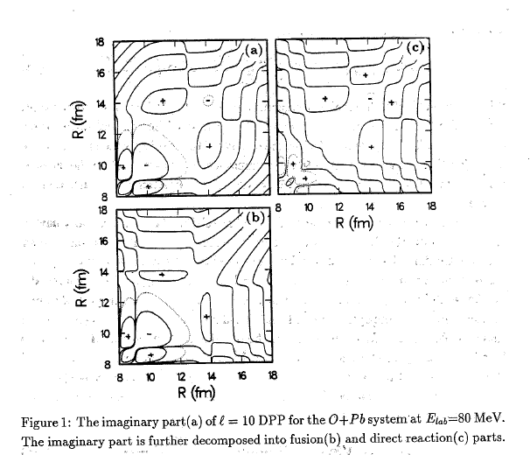
4. Dynamic Polarization Potential

Slide 3
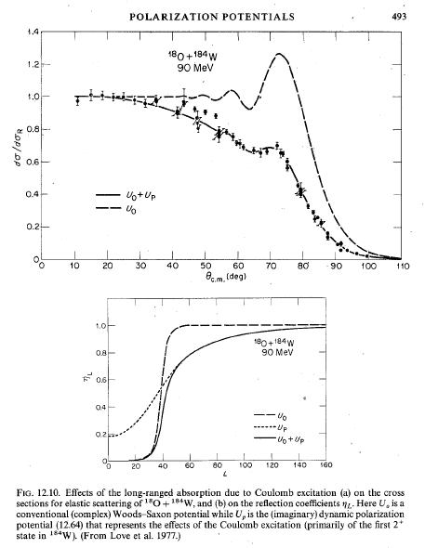
4. Dynamic Polarization Potential

Slide 4
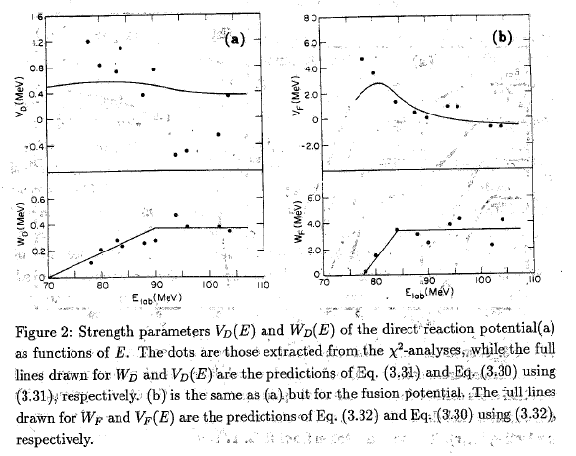
4. Dynamic Polarization Potential

Slide 5
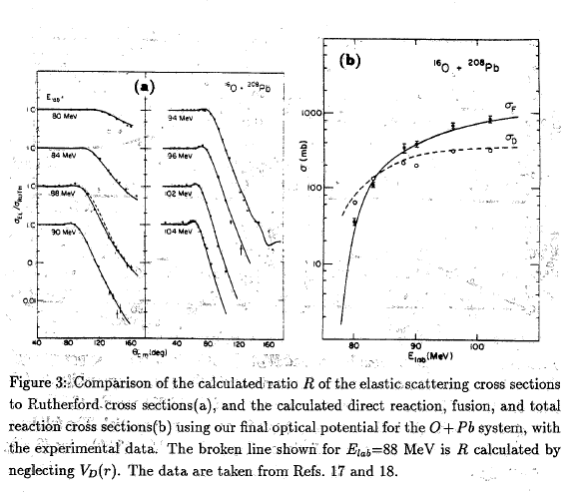
4. Dynamic Polarization Potential

Slide 6
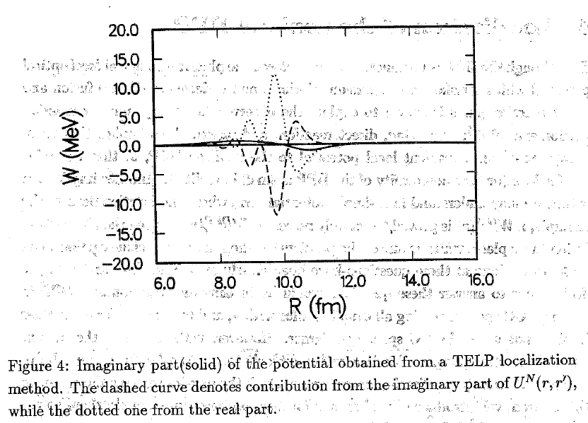
4. Dynamic Polarization Potential

Slide 7
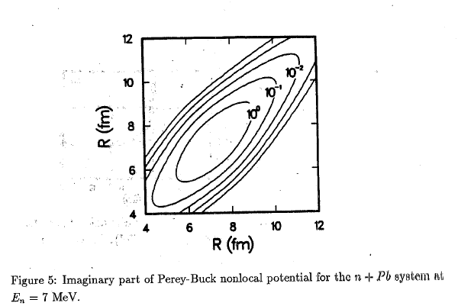
4. Dynamic Polarization Potential

Slide 8
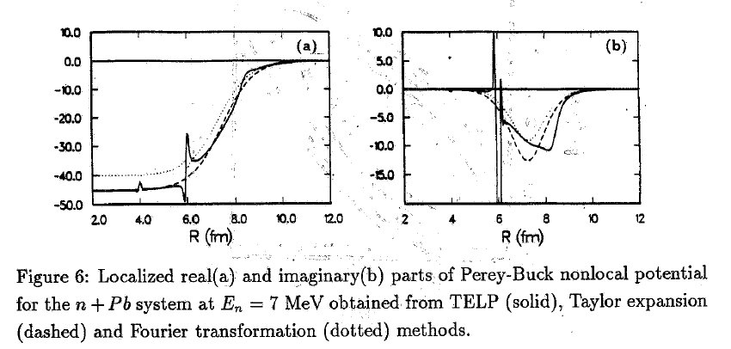
4. Dynamic Polarization Potential

Slide 9
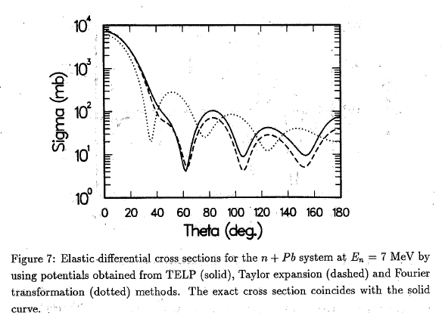
4. Dynamic Polarization Potential

Slide 10
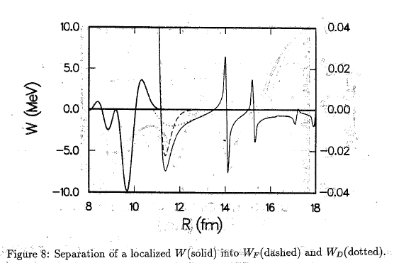
4. Dynamic Polarization Potential

Slide 11
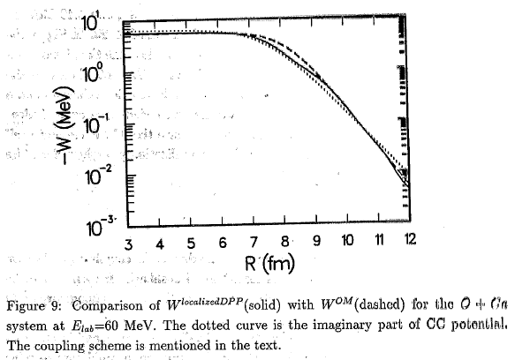
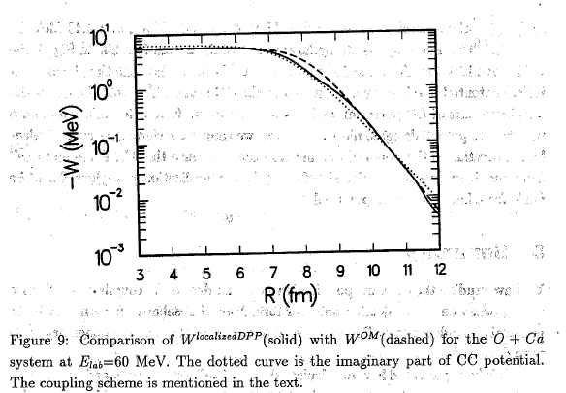
4. Dynamic Polarization Potential

